Slide 1


CSM3114 - FRAMEWORK
STUDENT
GRAB
Name : Muhammad Irfan Hakim
Matric Number : S62113
Date : 8 January 2024

Slide 2
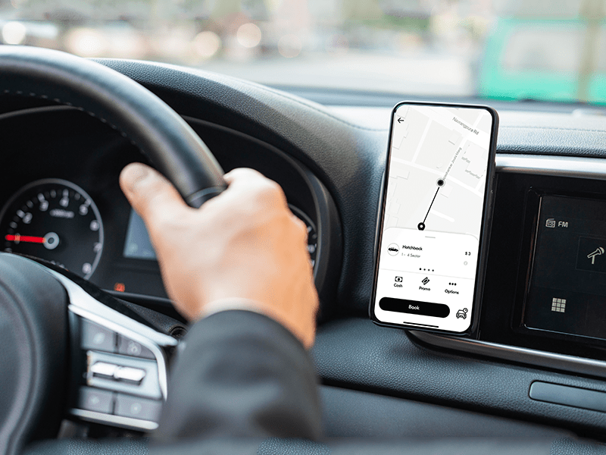
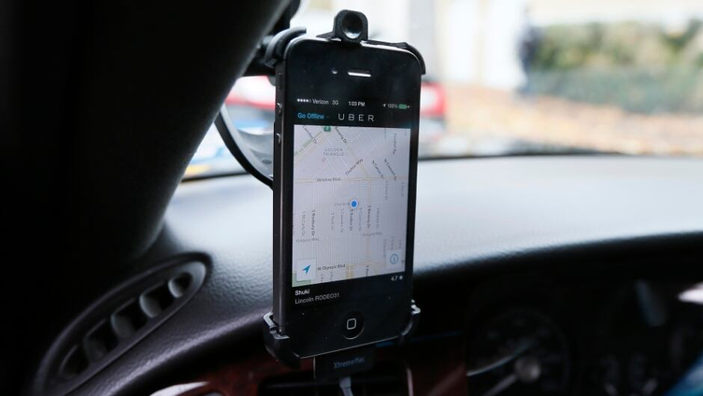

CSM3114 - FRAMEWORK
Overview of project
Objective : Develop a dedicated ride-sharing app for campus students using Flutter framework for streamlined user experience.
Simple interface for students to request
rides within campus boundaries.
Core
features
Easy onboarding process for students interested in becoming drivers.
User-friendly platform for feedback, fostering
community engagement and continuous improvement.

Slide 3
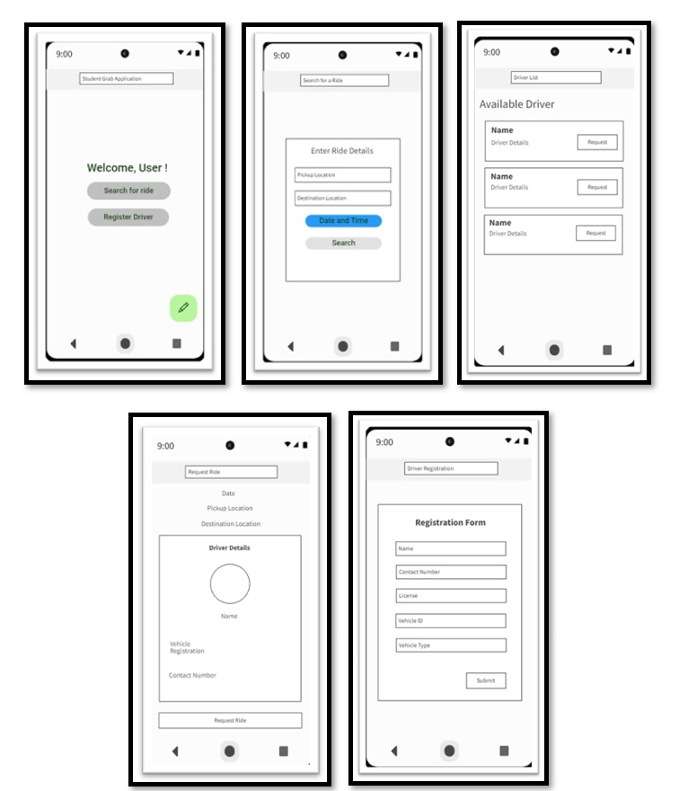

Wireframe of prototype

Slide 4
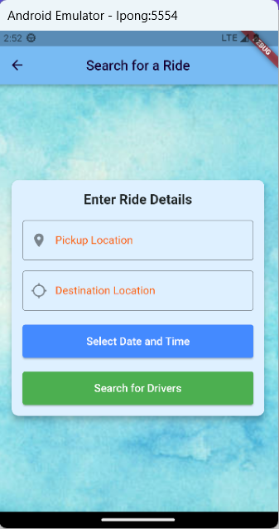
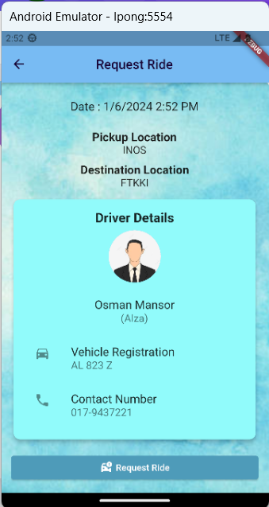
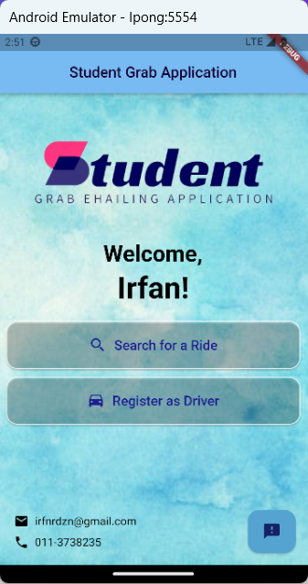
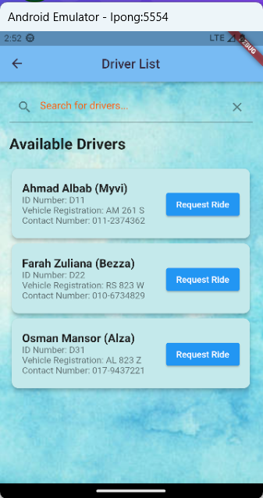
User Interface (UI)
HomePage
DriverListPage
SearchPage
RequestRidePage

Slide 5
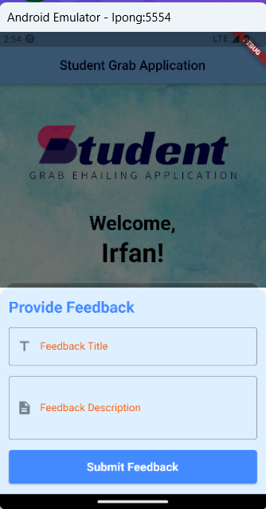
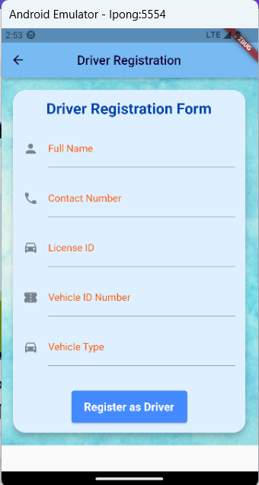
User Interface (UI)
DriverRegistrationPage
Feedback

Slide 6






















1. Mohamad Niza, Sabiroh Md Sabri, & Najiah Filzah. (2021, July 31). E-Hailing Service Satisfaction: A Case Study of Students in a Higher Education Institution in Perlis, Malaysia. ResearchGate; UiTM Press, Universiti Teknologi MARA. https://www.researchgate.net/publication/354655814_E-Hailing_Service_Satisfaction_A_Case_Study_of_Students_in_a_Higher_Education_Institution_in_Perlis_Malaysia
2. material library - Dart API. (2023). Flutter.dev. https://api.flutter.dev/flutter/material/material-library.html
3. Course: PEMBANGUNAN APLIKASI MUDAH ALIH BERASASKAN KERANGKA. (2023). Umt.edu.my.https://epembelajaran.umt.edu.my/oceania/course/view.php?id=10761
4. Bard. (2023). Google.com. https://bard.google.com/chat
5. ChatGPT. (2024). Openai.com. https://chat.openai.com
6. Produle. (2023). MockFlow - Wireframe Tools, Prototyping Tools, UI Mockups, UX Suite, Remote designing. Mockflow.com. https://mockflow.com/
References

